Slide 1
Artists with 10 Albums or More
Q1: Which artists have 10 or more number of albums?
The chart shows the names of artists who have done more than 10 albums, also shows the number of albums of the y-axis

Slide 2
Top 3 Customers and their Countries
Q2 Who are the top 3 customers based on amount they spent and which country do they belong to?
The chart shows the names of 3 customers who have spent most money and their country. The amount is shown on the x-axis and the country names on the y-axis.

Slide 3
Popularity of a Genre depending upon tracks
Q3 What genres are most popular?
The chart shows the names of genres on the x axis and the number of tracks on the y axis. Going from most popular genre to the least popular.

Slide 4
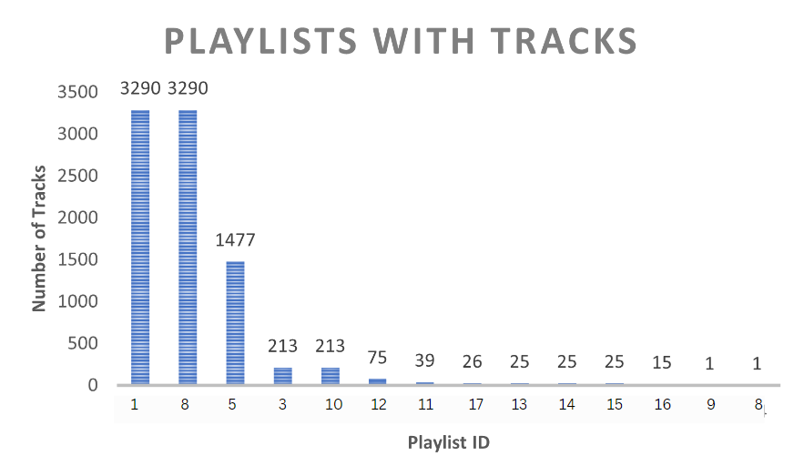
Playlists with tracks
Q4 How many number of tracks are there in each playlist?
The chart shows how many number of songs are in each playlist using the counting tracks on each playlist. The y axis shows number of tracks and x axis the playlist id.

